Slide 1
Native Apps & Appium

Slide 2
Agenda
Capabilities for Native Apps
Application Types
The Appium Driver – template & options
Interacting with Apps – contexts
Notes:
We focused on web applications so far. In this module we will look at native & hybrid applications.
Everything we have learned in web is valid with native apps, we just need to select the correct driver & context & then continue to use the same commands as before.

Slide 3
Capabilities for Native & Hybrid Apps

Slide 4
Instrumentation
Instrumentation enables working with the device sensors from within the application
Setting autoInstrument to true allows image injection, Face ID & Fingerprint ID features to run.
Hybrid applications require instrumentation, autoInstrument, for object retrieval to be supported.
Instrumentation needs to defined in the capabilities and cannot be turned on during script execution.
Notes:
Open the webpage and review the different options available.

Slide 5
Launching & Resetting Apps
Appium provides several options regarding resetting apps and deleting application data.
To decide the correct configuration for your organization, consider the following criteria:
Tests must run on latest version?
Does the test require app to open with no data or with it’s history (username etc.)?
In most cases the requirement is to always run the latest version and the data varies per type of test.

Slide 6
Launching & Resetting Apps
Resetting the app
The noReset & fullReset capabilities allow full app reset e.g. before & after execution.
The fullReset uninstalls the app if it is on the device, reinstalls the app & then uninstalls at the end of the execution.
The noReset disables the reset functionality.
Default behaviour is false i.e. these capabilities are not used.
Uninstalling & installing the app upon execution takes several minutes & is usually not needed per test.
Data Reset, dataReset, allows retaining app data when installing a new version.

Slide 7
What is the correct configuration?
The solution resides usually outside the test.
A single execution is not the best place to handle the application installation & data.
Perfecto supports CI connection where the tests are run automatically.
In a CI context, we recommend installing the latest app version, with instrumentation, at the beginning of the cycle.
Individual tests can overwrite the general setting if the test requires it.
We will revisit this issue in the CI connection module.

Slide 8
Bundle ID & App Packages
Launching an app by name is possible but launching according to Appium guidelines enables more functionality e.g. passing arguments, opening in a specific page and more.
Perfecto recommends always using the Appium best practices.
iOS - The bundleId capability is the current way to identify an app. This ID is not available from the Perfecto interface and needs to be provided by the Dev team.
The bundle ID is app specific and does not change per version.

Slide 9
Android Configurations
The app identifier e.g. com.android.calendar identifies the app and launches it.
Android allows opening a specific page, or activity, inside the application with the appActivity capability.
XXX

Slide 10
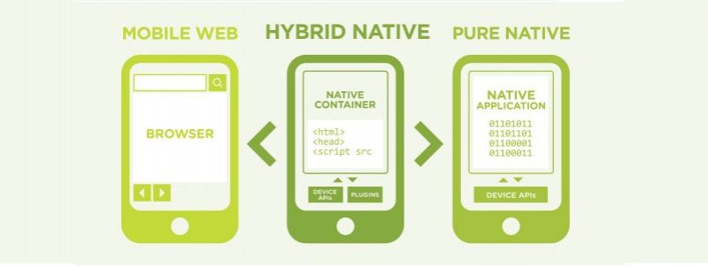
Application Types

Slide 11
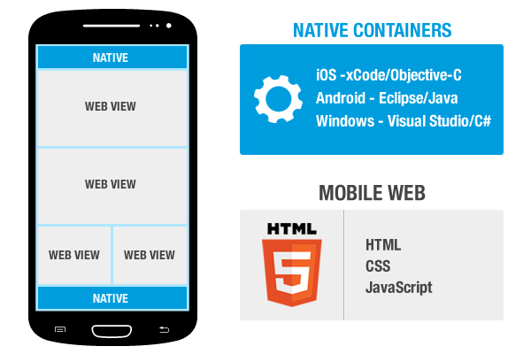
Hybrid Applications
Hybrid Applications are composed of a Web portion shared across platforms & a Native option unique to the OS
Each part of the application requires its own context.
Learn the application you are working on to see what type it is and which elements are Web and Native.
Notes:
This sounds complicated but remember that it is static. In most hybrid apps the web/Native parts are clearly differentiated e.g the menu will be Native and the content Web.

Slide 12
The Appium Driver
Working with Native Apps is very similar to websites
Native Apps require an Appium driver
The driver can be selected when creating the project.
When working with a framework, it should select the correct driver automatically.
Notes:
Native Apps require the Appium Driver. Launching it is easy, select the Java Appium project type and then the correct driver.

Slide 13
The Appium Driver continued.
There is a driver per platform, both are available in the template
Uncomment & use the one you require for the test.
AndroidDriver driver = new AndroidDriver(new URL("https://" + host + "/nexperience/perfectomobile/wd/hub"), capabilities);
OR IOSDriver driver = new IOSDriver(new URL("https://" + host + "/nexperience/perfectomobile/wd/hub"), capabilities);
Notes:
Automatic driver selection is available in Perfecto’s Quantum framework. If you are going to use it then this will be happening automatically for you. If you are planning to use another FW we recommend adding this functionality to it and can assist in doing it.

Slide 14
Interacting with Apps – Contexts
We have used Contexts to switch between Objects & Visual methods.
Applications have their own context switchToContext(driver,"NATIVE_APP");
switchToContext(driver,"NATIVE_APP");
switchToContext(driver,"NATIVE_APP");
The Native context is the default when using the Appium Driver.
Switching contexts will be needed when:
The Native App open a Web browser
Hybrid App contains both Web & Native Elements
Visual Analysis is used.

Slide 15
Thank You

